Slide 1
Modelling RESTful services for NEM
Denis Baltor
V1.1
31/01/2017
Security Classification: Internal

Slide 2
REST
Key Concepts
“The web is an existence proof of a massively scalable distributed system that works really well, and we can take ideas from that to build integrated systems more easily.”
Martin Fowler

Slide 3
Very Simple Description
REST leverages the capabilities of Hypertext Transfer Protocol (HTTP) and Uniform Resource Identifiers (URIs) to retrieve or modify the state of a resource.

Slide 4
Resources
“The key abstraction of information in REST is a resource...” - Roy Fielding’s dissertation.
Resources form the nucleus of any REST API design. Resource identifiers (URI), Resource representations, API operations (using various HTTP methods), etc. are all built around the concept of Resources. It is very important to select the right resources and model the resources at the right granularity while designing the REST API in order to achieve maintainable.
A resource can be a singleton or a collection. For example, “customers” is a collection resource and “customer” is a singleton resource.
https://www.thoughtworks.com/insights/blog/rest-api-design-resource-modeling

Slide 5
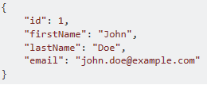
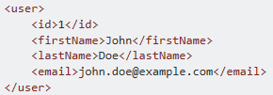
Resource Representation
A resource can be represented in multiple formats, such as JSON, XML, YAML, etc.
In JSON, the representation would be:
In XML, the representation would be the following:
https://www.thoughtworks.com/insights/blog/rest-api-design-resource-modeling

Slide 6
OpenAPI (Swagger)
Standardizing how REST APIs are described

Slide 7
OpenAPI 2.0
A Swagger 2.0 file is made of 15 standardized sections, open to extensions. Only 3 of these sections are required (denoted below with bold face). These 15 sections fall into 5 main categories:
A mandatory header section (swagger)
Meta data around the API being described (info, tags, externalDocs)
Global configuration (host, basePath, schemes)
The API description (consumes, produces, paths, definitions, parameters, responses)
Security related descriptions (securityDefinitions, security).

Slide 8
A RESTful Service’s URI in Swagger Terms
https://<server_name>:<port>/<service_name>/<resource_name>
schemes
host
basePath
path

Slide 9
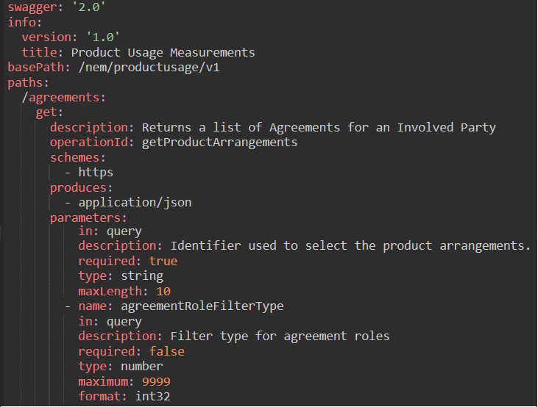
Swagger Example

Slide 10
Swagger (schemes, basePath, paths)

Slide 11
Swagger (Service Versioning)
Major Version only

Slide 12
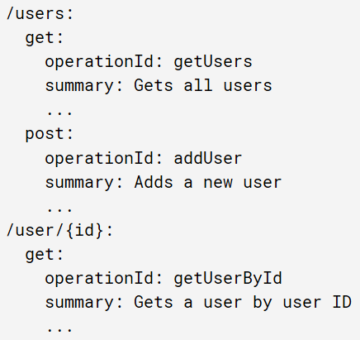
Swagger (More on paths and operations)
In OpenAPI terms, paths point to resources that the API exposes, such as /users or /user/{id}, and operations accessed by HTTP verbs , such as GET, POST or DELETE, manipulate those resources.

Slide 13
Swagger (Data Models)
Primitive data types in the Swagger Specification are based on the types supported by the JSON-Schema Draft 4. Models are described using the Schema Object which is a subset of JSON Schema Draft 4.
https://github.com/OAI/OpenAPI-Specification/blob/master/versions/2.0.md

Slide 14
Structuring a complex schema
When writing computer programs of even moderate complexity, it’s commonly accepted that “structuring” the program into reusable functions is better than copying-and-pasting duplicate bits of code everywhere they are used. Likewise in JSON Schema, for anything but the most trivial schema, it’s really useful to structure the schema into parts that can be more easily read and consistently reused.
https://spacetelescope.github.io/understanding-json-schema/structuring.html

Slide 15
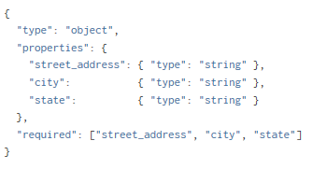
Structuring a complex schema – Cont’d
So let’s start with an inline schema that defines an address :
https://spacetelescope.github.io/understanding-json-schema/structuring.html

Slide 16
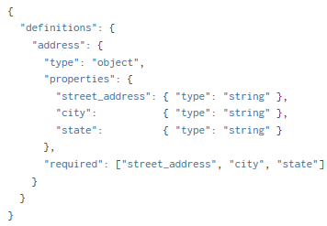
Structuring a complex schema – Cont’d
Since we are going to reuse this schema, it is customary (but not required) to put it in the parent schema under a key called definitions
not anymore anonymous
https://spacetelescope.github.io/understanding-json-schema/structuring.html

Slide 17
Structuring a complex schema – Cont’d
We can then refer to this schema snippet from elsewhere using the $ref keyword.
https://spacetelescope.github.io/understanding-json-schema/structuring.html

Slide 18
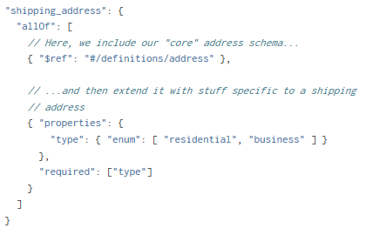
Structuring a complex schema – Cont’d
The power of $ref really shines when it is combined with the combining keywords allOf, anyOf and oneOf.
https://spacetelescope.github.io/understanding-json-schema/structuring.html

Slide 19
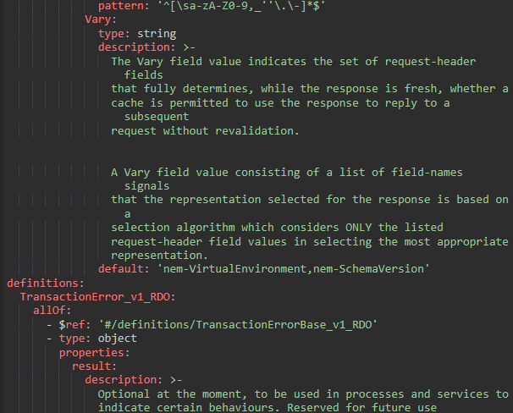
Swagger (definitions)

Slide 20
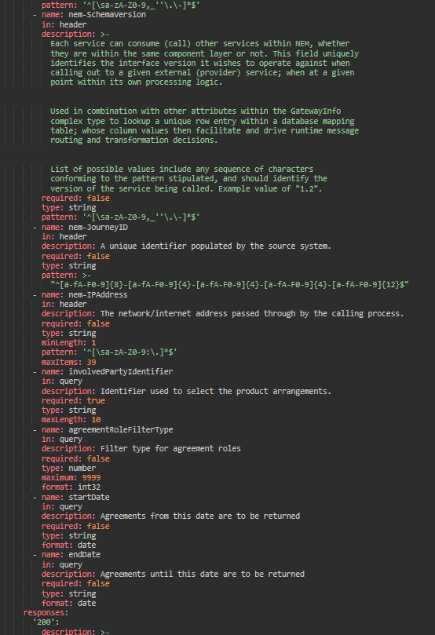
Swagger Files Grow Wildly in the Real World

Slide 21
RSA 9.6.1
Model-Driven Design of RESTful services

Slide 22

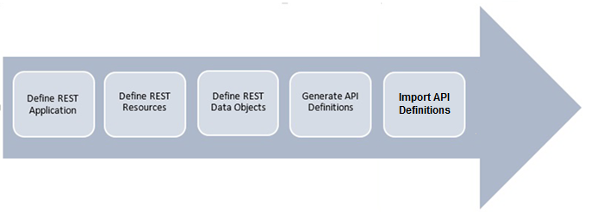
REST API using RSA and IIB
With the Swagger and REST profiles you can model in UML consumable APIs with:
Consistent resource names
Common query parameters
Simple JSON/XML data structures
RSA
IIB

Slide 23
REST Applications (Services)
The REST Application represents the set of Resources being provided by the service. They define the scope of a service and the path dependencies between Resources.
The REST Application defines the Swagger basePath and therefore the component to be versioned.
Stereotype: <<SwaggerApp>>

Slide 24
REST Resources
A resource is an addressable artefact on the web. They are objects with a defined type, associated data, methods (HTTP verbs) that operate on them, and relationships to other Resources within Application. They can be:
Collection Resources
Member Resource
Member Virtual Resources (defined by the enclosing collection)
Stereotype: <<Resource>>
Resources can have links to other resources which are UML dependency relationship applied to control how URIs can be constructed.
Stereotype: <<Path>>

Slide 25
REST Operations
An operation define a method that operates on a resource. It is accessed via some HTTP verb.
Stereotype: <<SwaggerOperation>>
Stereotype:
<<GET>>
<<PUT>>
<<POST>>
<<DELETE>>

Slide 26
REST Data Objects (Transfer Objects)
The data associated with Resources are modelled as classes (and can be called REST Data Objects or RDOs).
RDOs allow you to explicitly define, at modelling time, the structure of the JSON/XML messages that will be used in the APIs.
Stereotypes: <<Swagger Definition>> <<Swagger Property>>

Slide 27
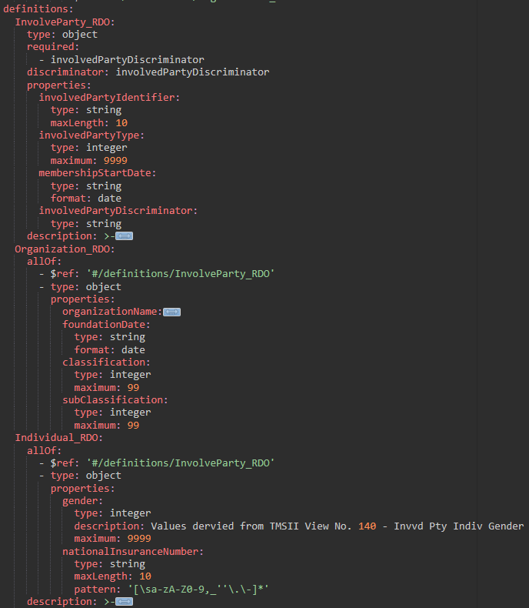
Swagger - Inheritance and Polymorphism

Slide 28
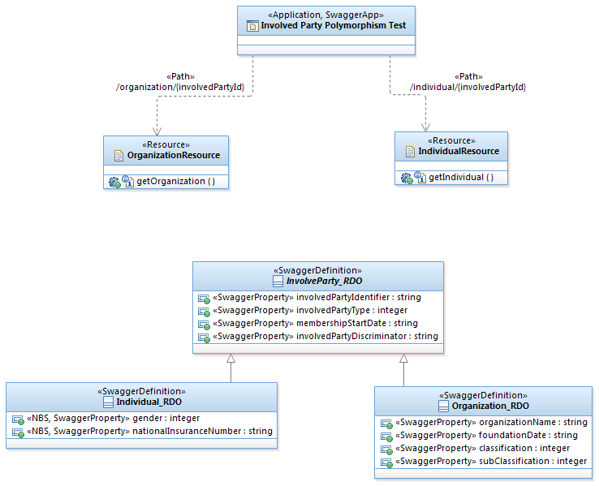
Application + Resources + RDOs = REST service
Service (/nem/ippt/v1)
URIs
Resources and its Operations
(HTTP verbs)
Data Model
(Resource Representation)

Slide 29
Propositions
Wrapping up

Slide 30
Propositions
Versioning
Major version numbers on basePath
Modelling RESTful service RSA using stereotypes:
SwaggerApp
Resource / Path
SwaggerOperation
SwaggerParam / SwaggerResponse / SwaggerHeader
SwaggerDefinition / SwaggerProperty

Slide 31
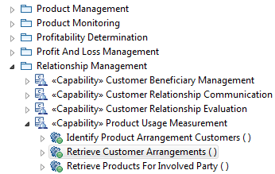
Propositions
Create a new model for NEM RESTful services (NEM_RS)
Not changing/extending IFW models
But keeping traceability via <<derive>> relationship
WS
REST

Slide 32
Propositions
RSA Model Structure
uk/co/nationwide/RESTfulServices
/Applications
<service name>
<major version number>
Data Objects
Resources
<class diagram>
<application class>
/Definitions (common)
CoreDataTypes
Enumerations

Slide 33
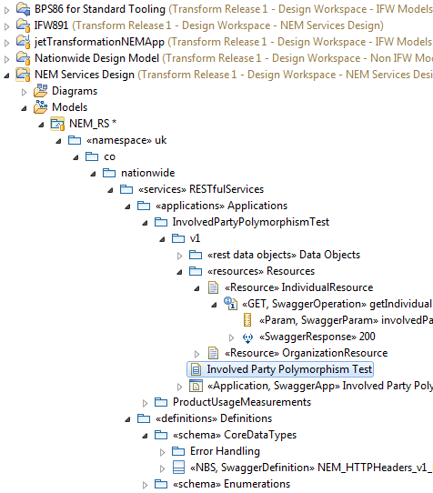
Propositions
Service
Service

Slide 34
Thank you

Slide 35
Backup Slides

Slide 36
OpenAPI 2.0 vs 3.0
What changed?

Slide 37
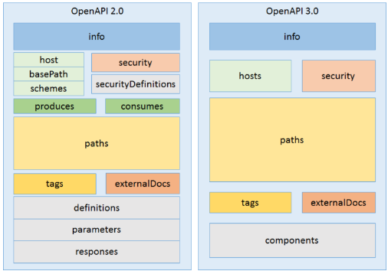
OpenAPI 2.0 vs 3.0

Slide 38
OpenAPI 3.0.0 (What’s new)
Structure rearranged for easier and extended reusability.
Extended JSON Schema support to include `oneOf`, `anyOf` and `not`.
Allowed the use of schema in parameters.
Added support for Cookie parameters and eliminated dataForm.
Body parameters were extracted to their own entity.
Added support for content type negotiation.
Introduced a new format to allow static linking between responses and future requests.
Simplified and enhanced security definitions of APIs.
Added a callback mechanism to describe WebHooks.
https://www.openapis.org/blog/2017/01/24/a-new-year-a-new-specification

